Slide 1

HOSPITAL MANAGEMENT:

Slide 2
Project Members(Group 3)
Dhananjaya K S 2489437
Durre Afshan 2489555
G K Pallavi 2488144
G S Dheeraj 2489411
Gauri Ramesharao khasale 2489421
Gollena Ashish 2489168
Gorla Sreevani 2488987
Goutham R 2489275
Gurram Purna chander 2489366
Guruvishnu S 2487684

Slide 3
Contents:
Introduction
Why do we use hospital management system ?
Objectives
Modules of hospital management system
Advantages and disadvantages.
Tools & languages used
System Requirements
App Flow
Features Available
Future Scope & Improvement
Conclusion

Slide 4
Hospital management system :
Hospital Management System brings together all the information and processes of a hospital, in a single platform.
It presents you with a unified 360-degree view for managing patients, doctors, inventory, appointments, billing information, finances and much more.
The system automatically generates a highly-efficient process and makes it quick. Thereby, allowing hospitals to provide quality service in addition to professional medical care.
In a nutshell, Hospital Management System (HMS) creates a frictionless approach towards managing the entire hospital and solves all complexities in the process.

Slide 5
Why do we use hospital management system ?
Cost Effective Reduction
Reduction in Errors
Data Security & Retrieving Ability
Quality & Compliance

Slide 6
Objectives :
Design a system for better patient care.
Provide MIS report on demand to management for better decision making.
Provide top management a single point of control.
The Hospital Management System can be entered using a username and password.
Hospital Management System enables you to develop your organization and improve its effectiveness and quality of work.

Slide 7
Modules of hospital management system :
Admin Module
Patient Module
Doctor Module
Appointment Module
Discharge Module
Feedback Module

Slide 8
ADMIN MODULE :
In the Admin Module the Admin could login and signup .
The Admin can see the Doctor List, Patient List and Feedback List.
In the Doctor’s List the Admin can perform UPDATE and DELETE operation.
In the Patient’s List the Admin can perform DELETE operation.

Slide 9
DOCTOR MODULE :
Doctor can Login and SignUp
Doctor can see the Appointment List and Discharge List
Doctor can DELETE the Appointment

Slide 10
PATIENT MODULE
Patient can Login and SignUp
Patient can see the Doctor List
Patient can Register the Appointment.
Patient can fill the form of Discharge Appointment
Patient can give the Feedback to the Doctor

Slide 11
Advantages :
Time-saving Technology
Improved Efficiency by avoiding human errors
Reduces scope for Error
Data security and correct data retrieval made possible
Cost effective and easily manageable
Easy access to patient data with correct patient history
Improved patient care made possible
Easy monitoring of supplies in inventory

Slide 12
Disadvantages:
Lack of employment is another such thing. The chances of employment usually become less with the automation of the system.
It is more expensive for the hospital.

Slide 13
TOOLS AND LANGUAGE USED :
Front End
Angular
Html
CSS
BOOTSTRAP
Back End
MySQL Server
Spring Tool Suite
Postman API

Slide 14
SYSTEM REQUIREMENTS :
The Basic System Requirements for Running this project are listed below:
Visual studio, STS, Postman and MySql to be installed to the system
1 GB Random Access Memory
200 MB of Free Space on Hard Disk
Microsoft Windows 8,10,11 or Linux or Equivalent OS
Web Browser (Microsoft Edge, Google Chrome)

Slide 15
Features available :
patientSignup
Login
Doctor details
Discharge form
Appointment
registration
Admin
Login
Create Admin Account
Doctor List
Patient List
Feedback
Doctor
Signup
Login
Appointment list
Discharged list

Slide 16
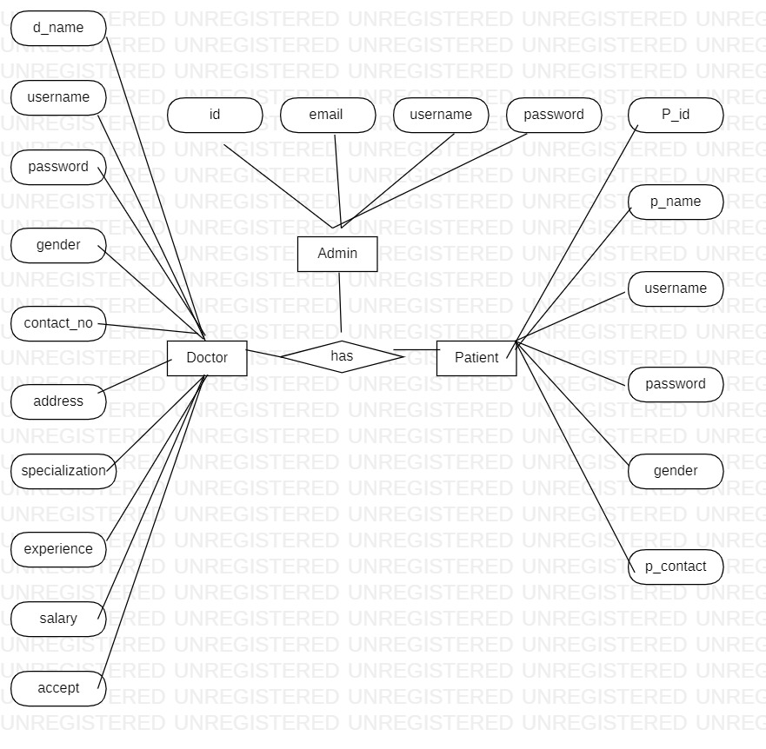
App flow :

Slide 17
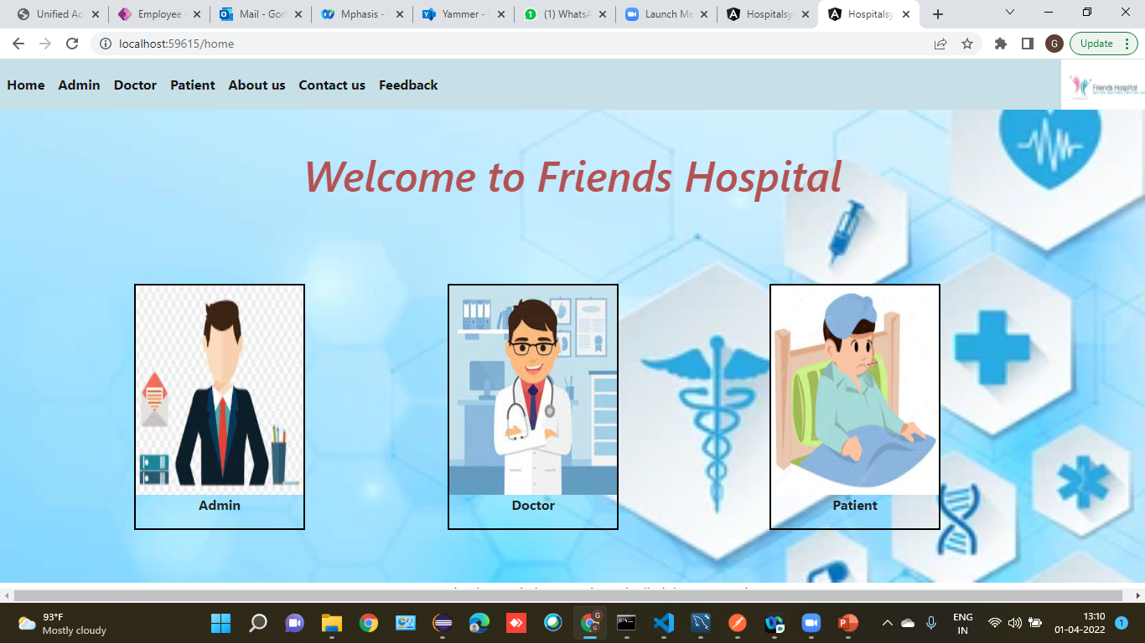
Home Page :

Slide 18
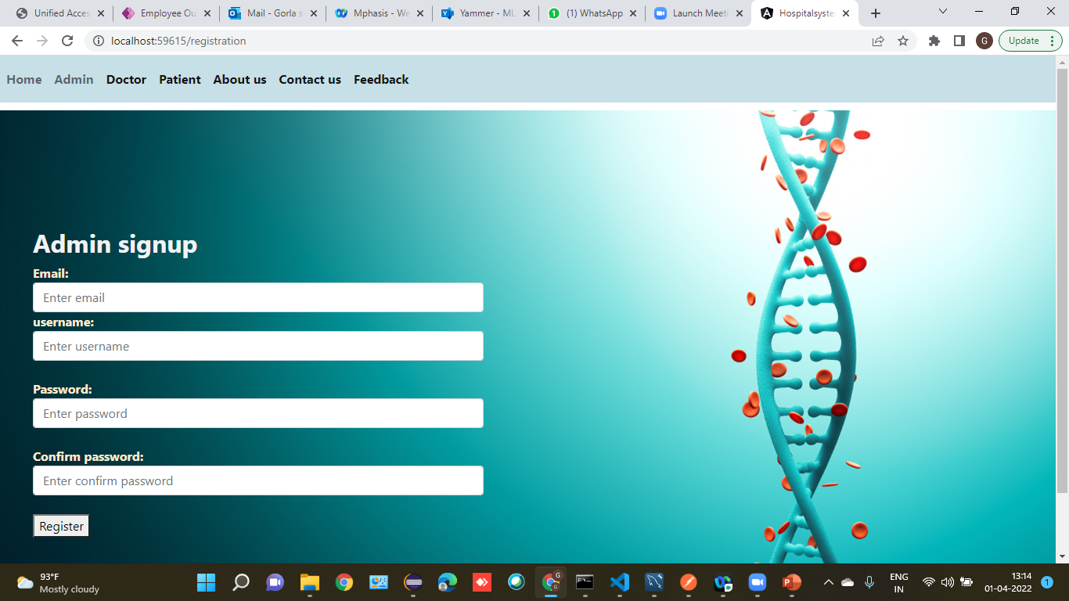
Admin signup :

Slide 19
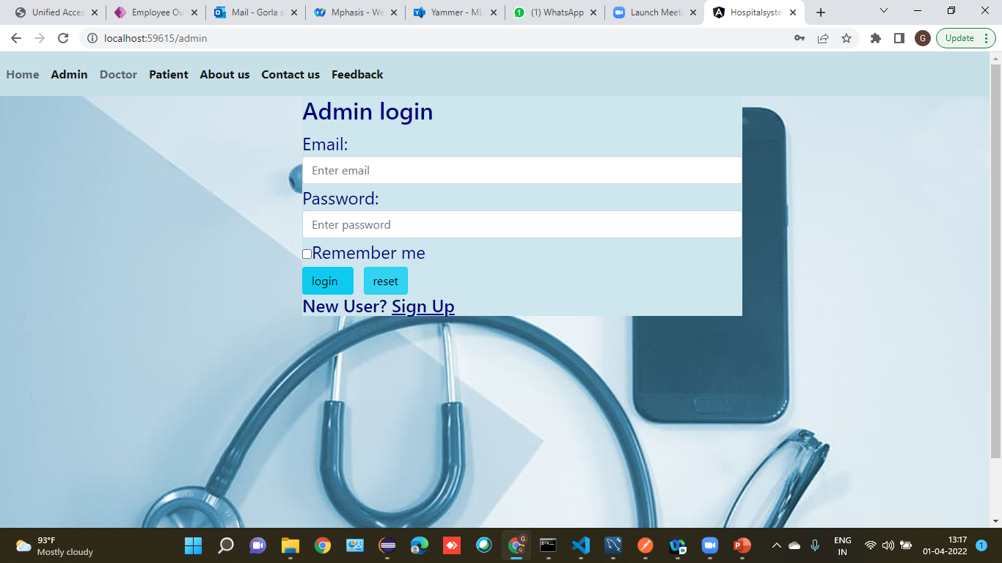
Admin login :

Slide 20
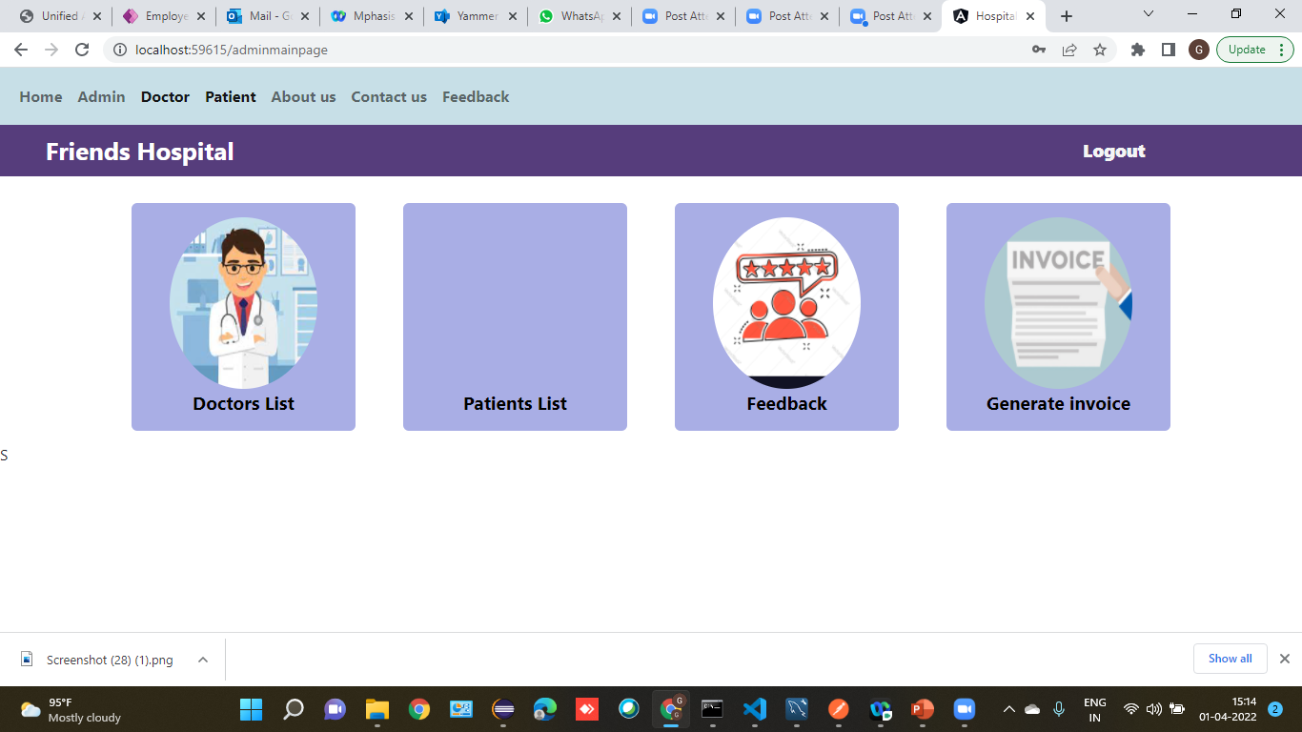

Slide 21
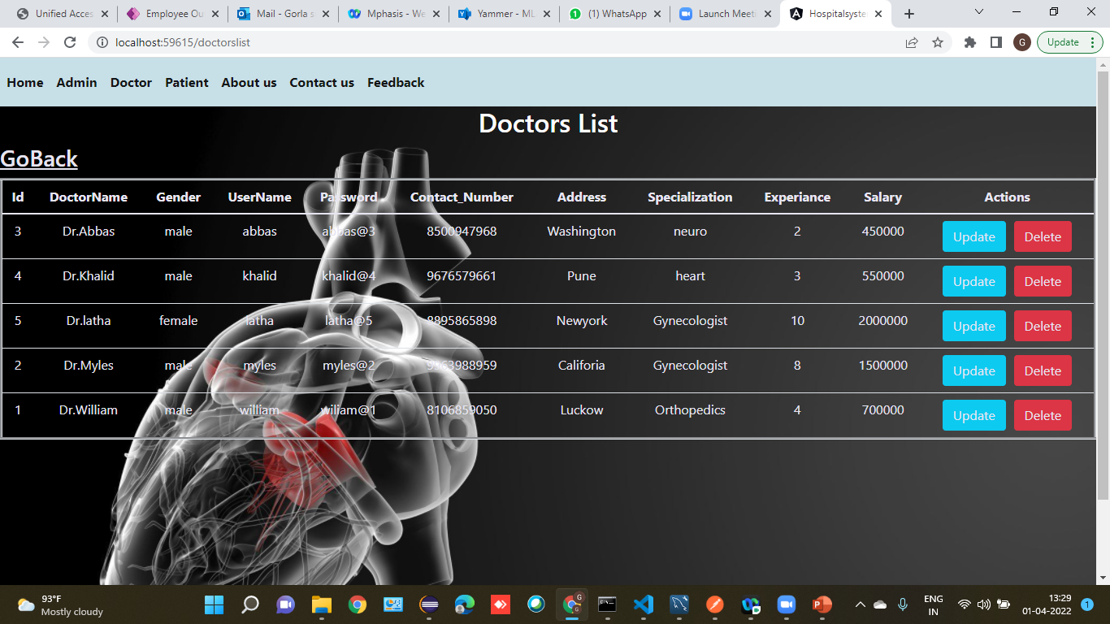
Doctors List :

Slide 22
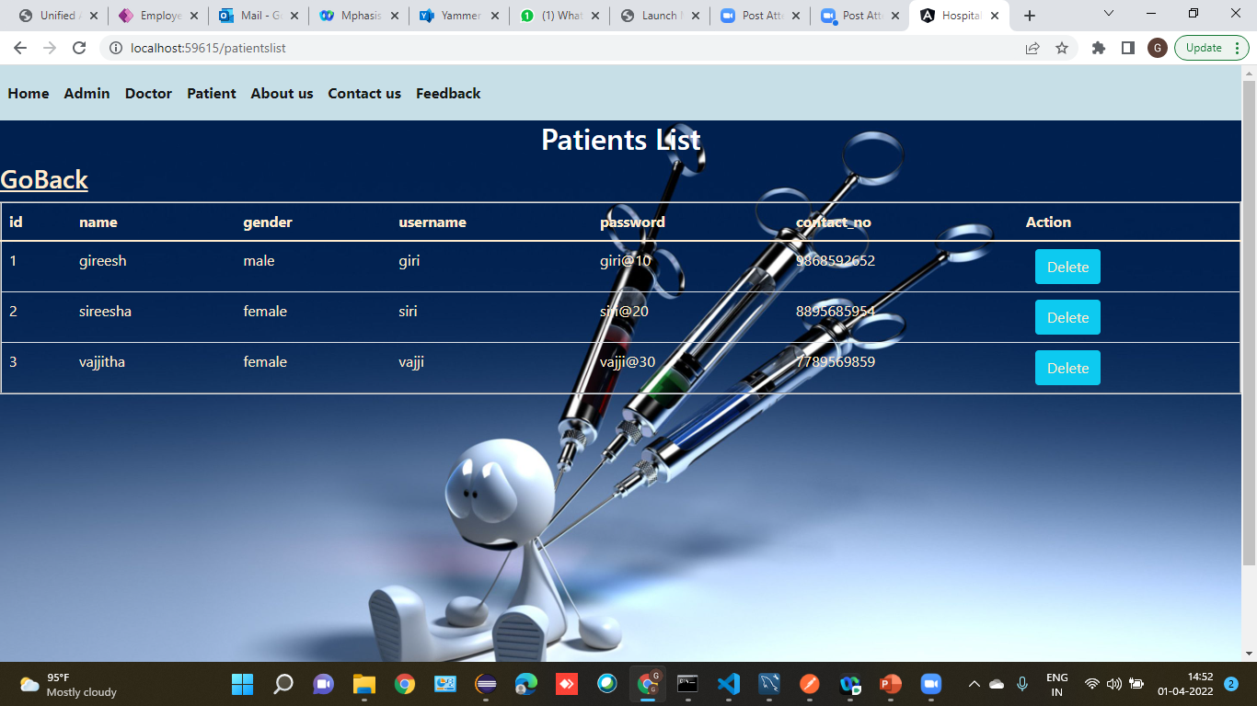
Patient List :

Slide 23
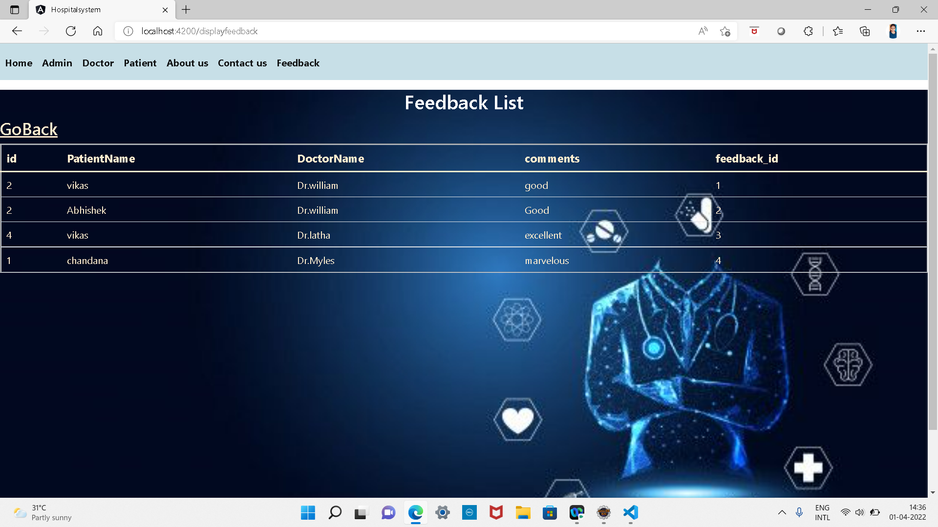
Feedback list :

Slide 24
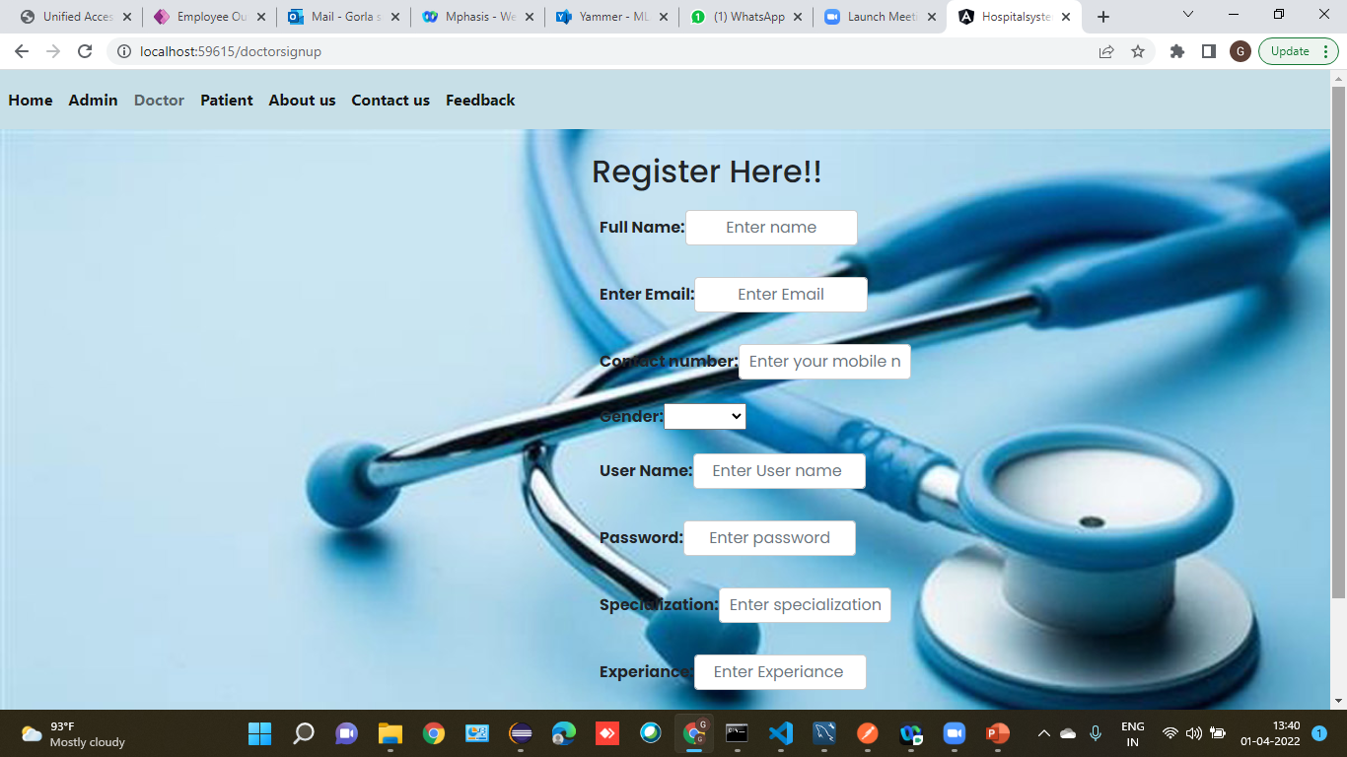
Doctor signup :

Slide 25
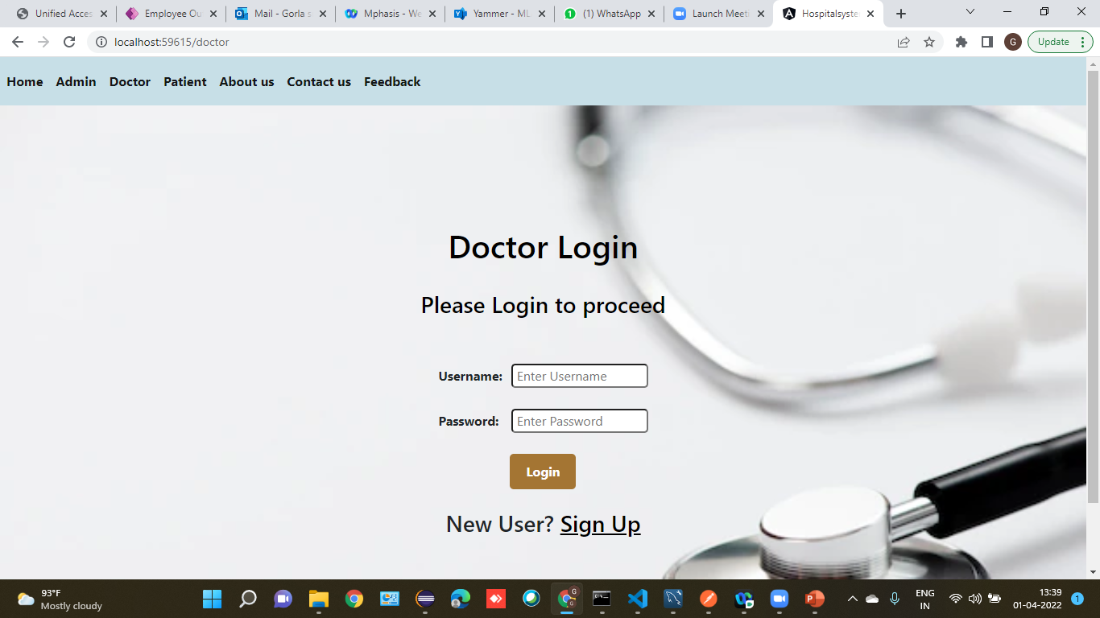
Doctor Login :

Slide 26
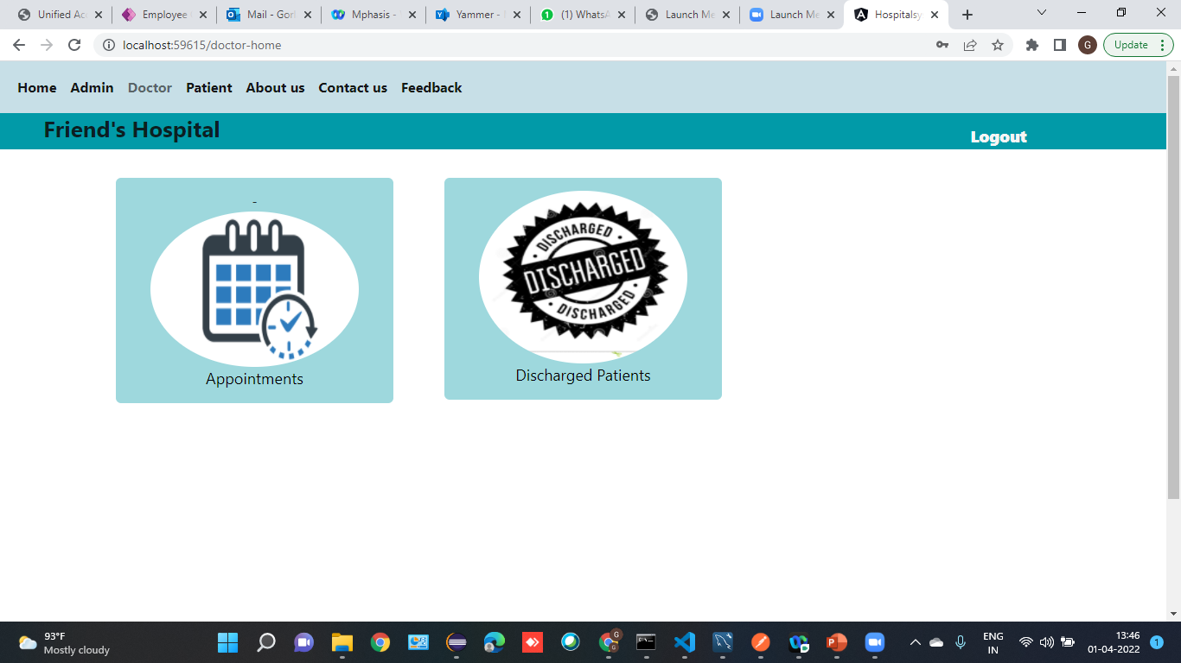

Slide 27
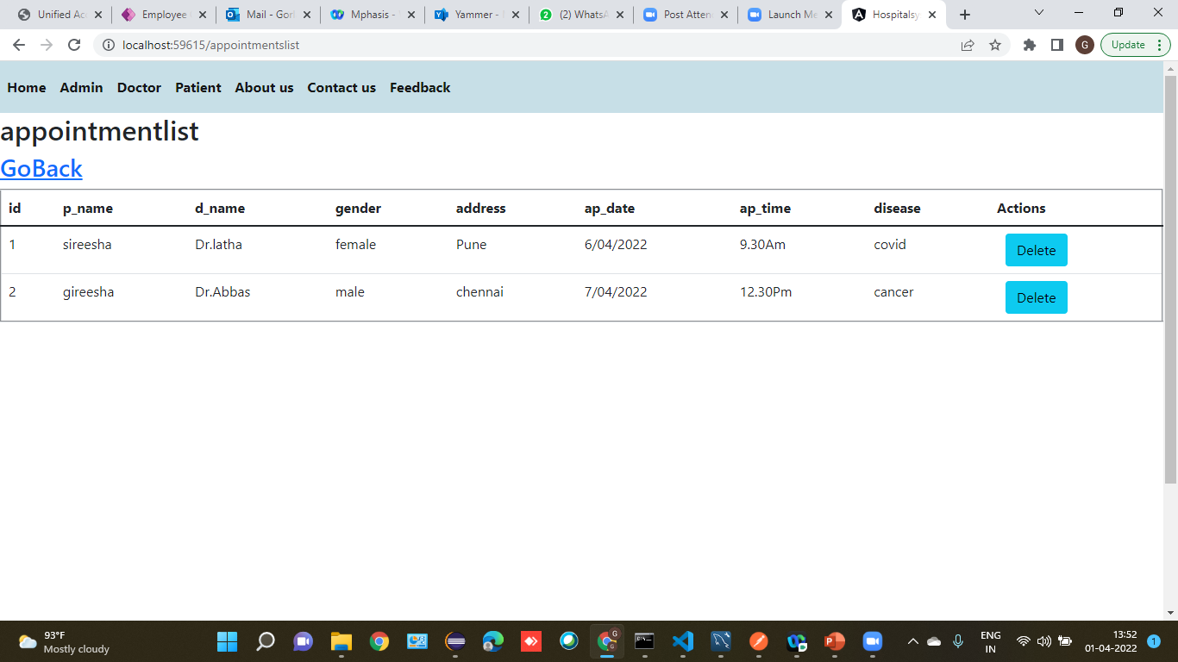
Appointment List :

Slide 28
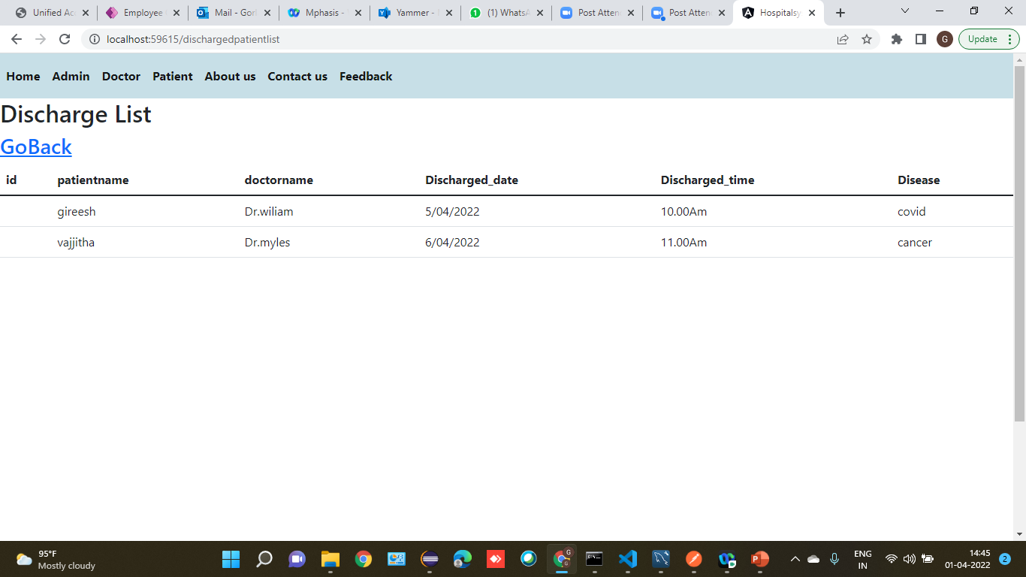
Discharge List :

Slide 29
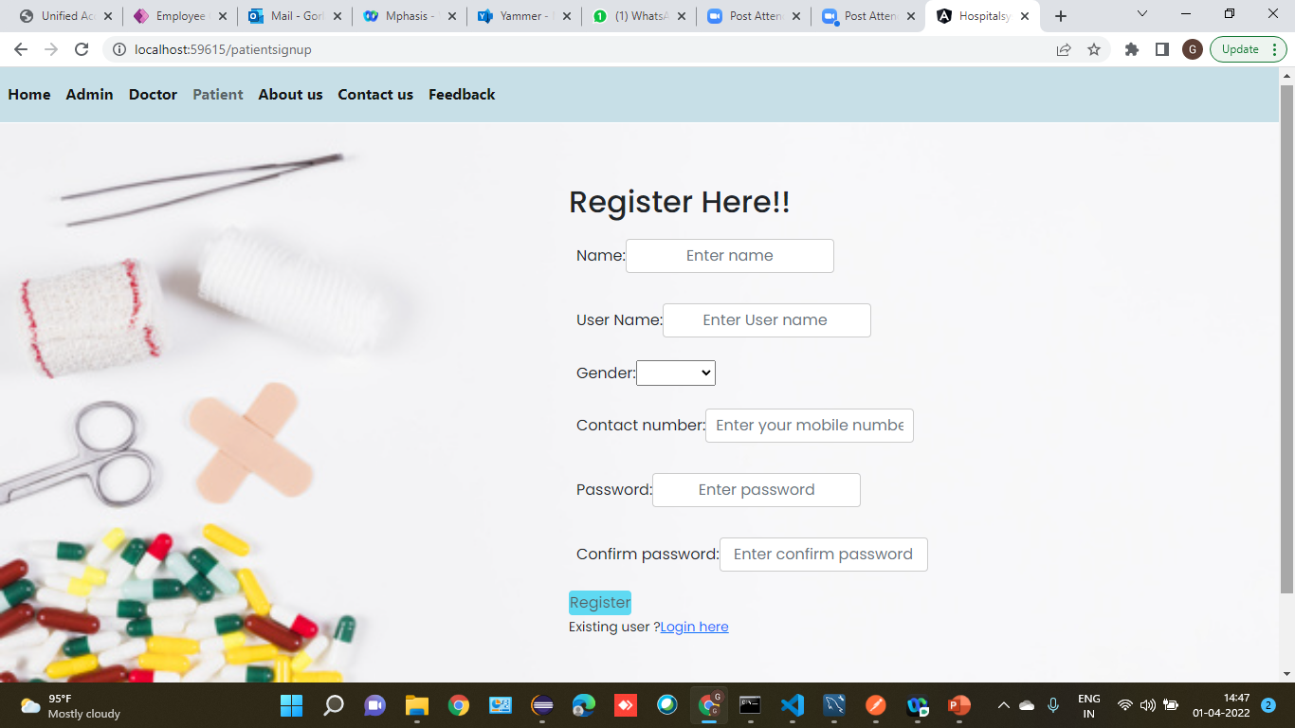
Patient signup :

Slide 30
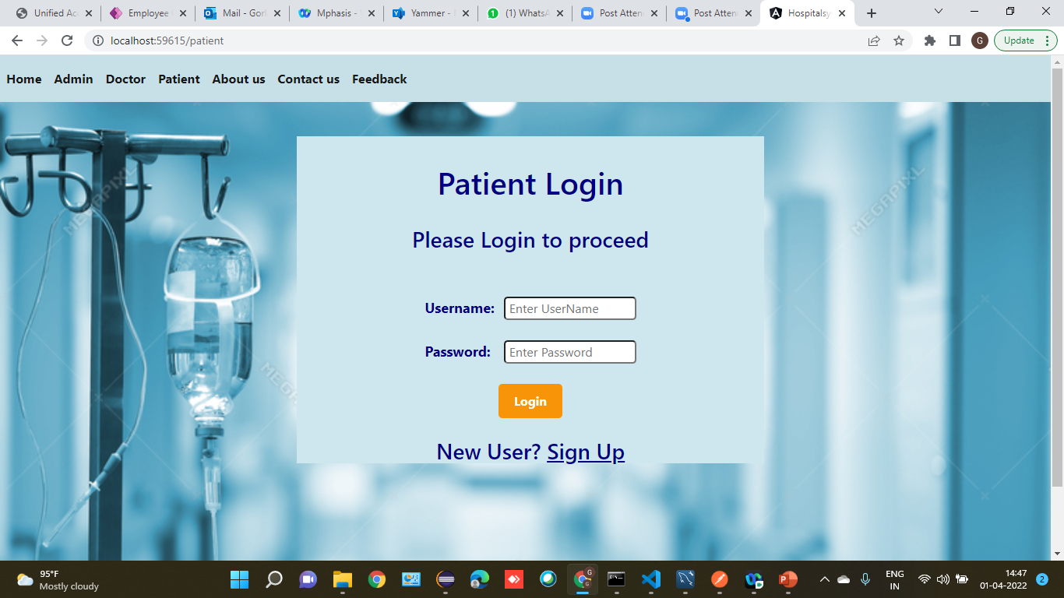
Patient Login

Slide 31
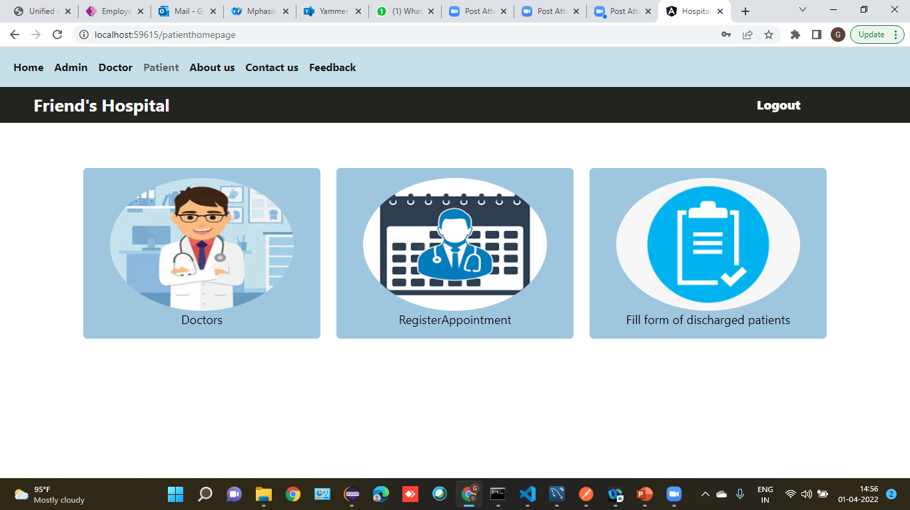

Slide 32
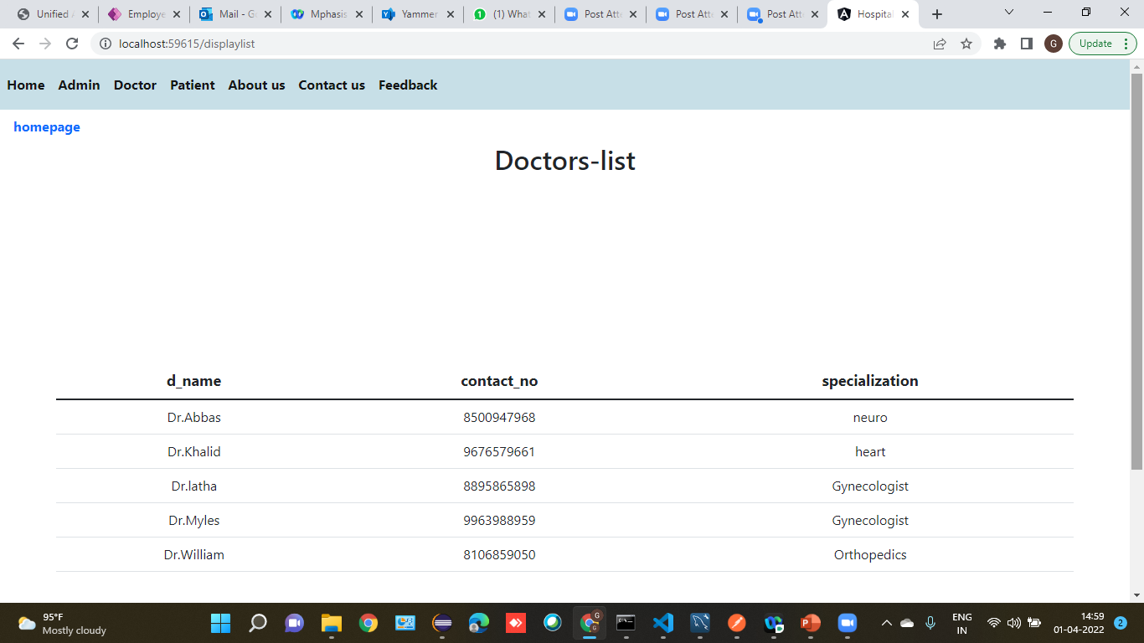

Slide 33
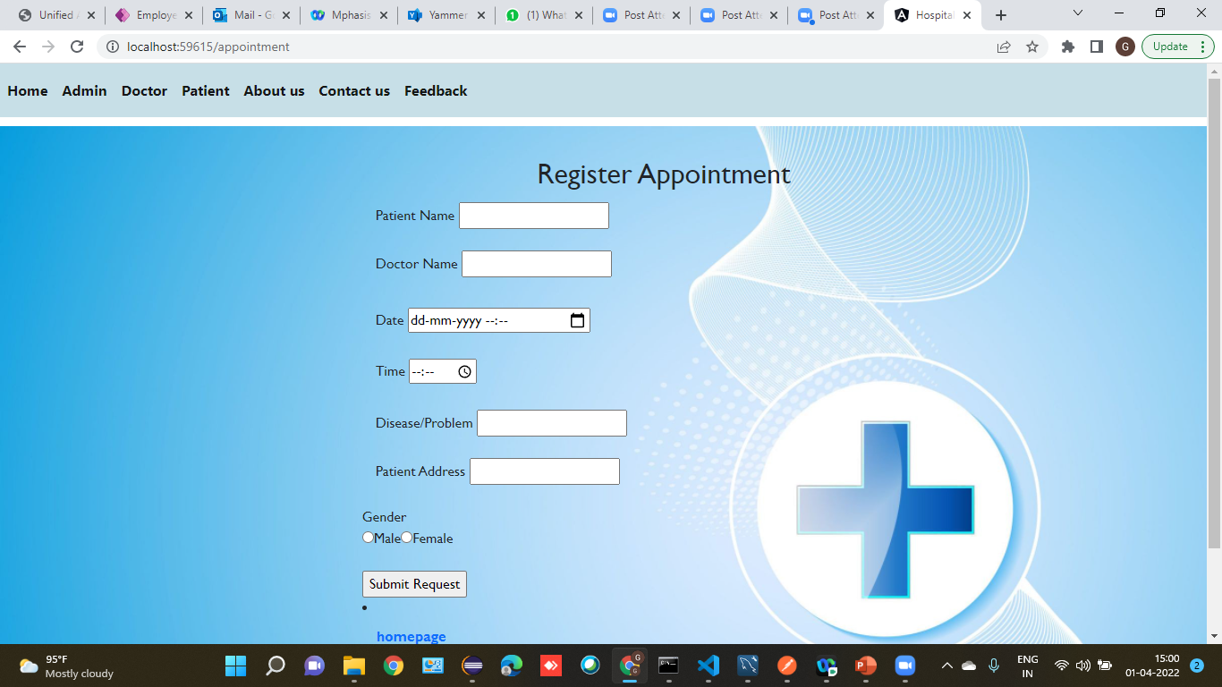
Register Appointment module:

Slide 34
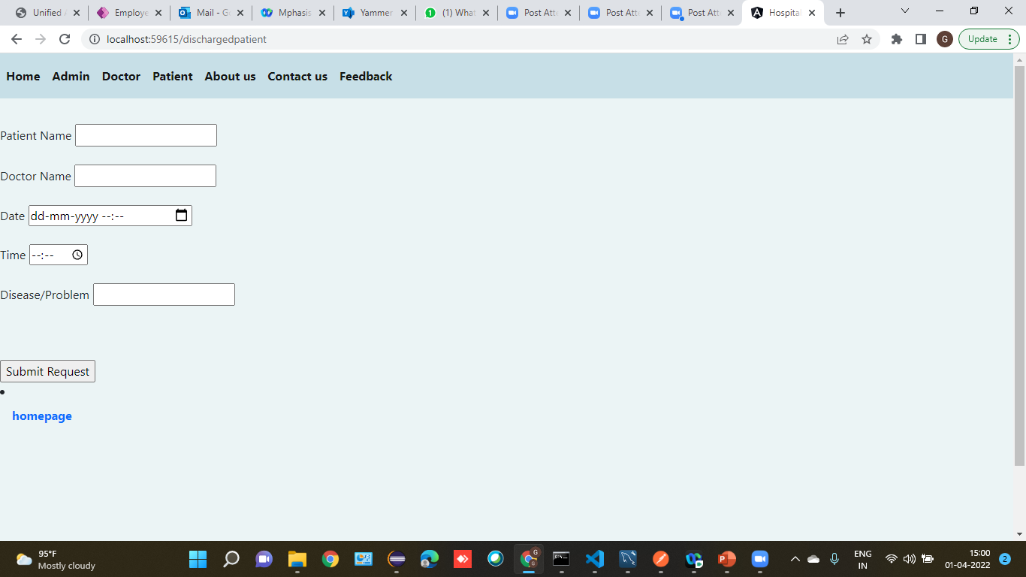
Discharge Form:

Slide 35
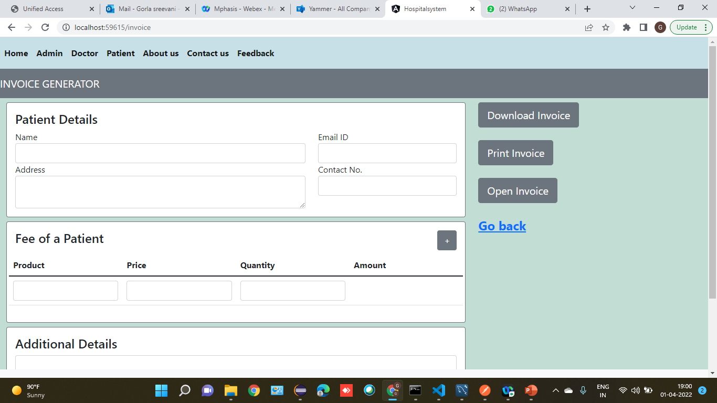
Generate Invoice :

Slide 36
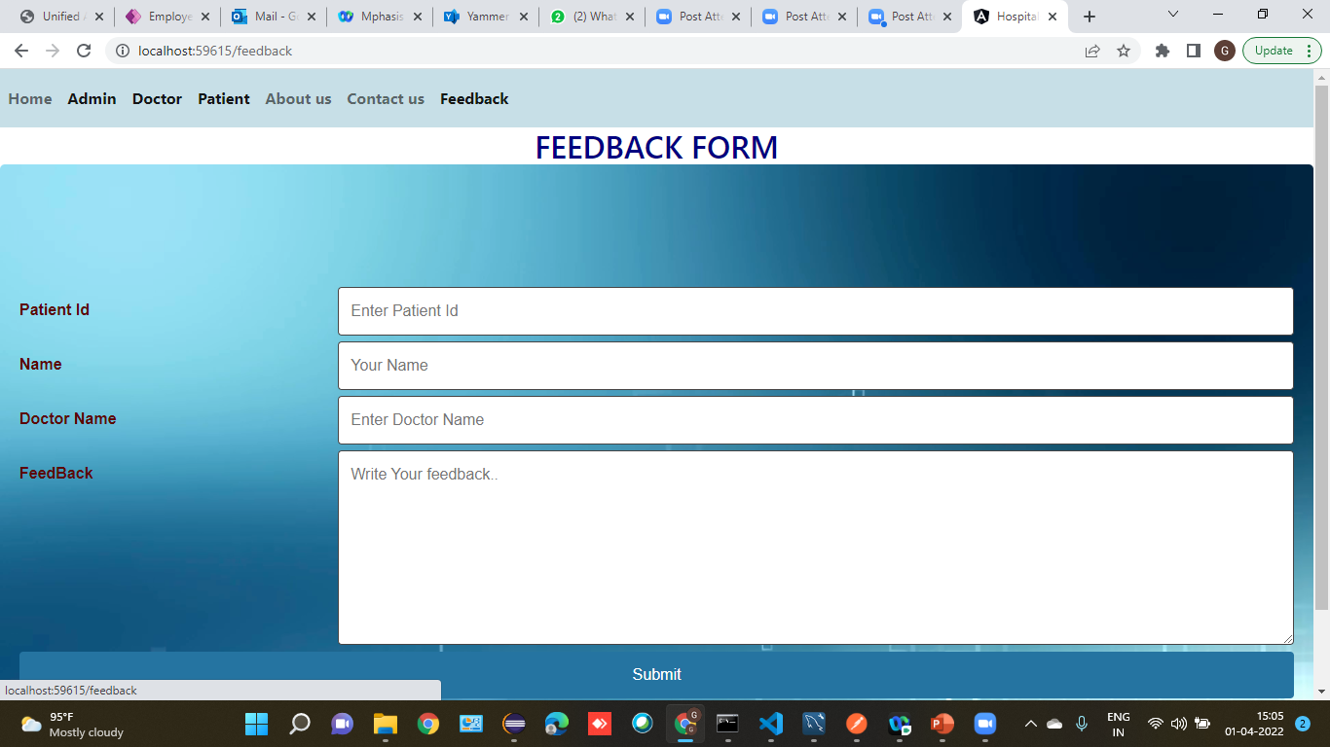
Feedback:

Slide 37
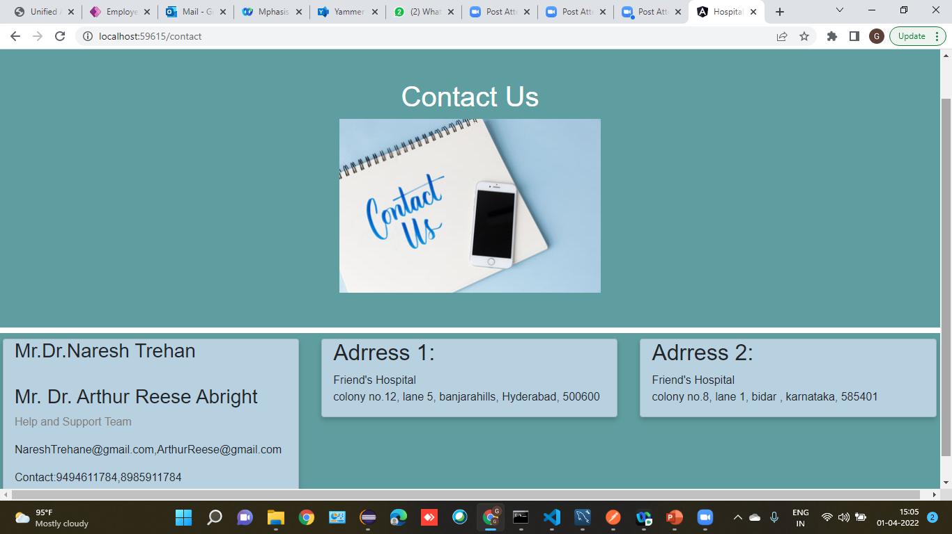
ContactUs:

Slide 38
Future scope & Improvements :
Hospitality is one of the fastest growing industries in the world today.
The proposed system is Hospital Management System, the system include more facilities like pharmacy system for the stock details of medicines in the pharmacy.
They providing such features enable the users to include more comments into the system.

Slide 39
Conclusion :
Hospital management systems allows us the ability to optimize and digitize all the processes within the institution.
It will help to improve customer service, reduce process costs, streamline the search of medical records, bills, patients, doctors, etc.
Hospital Management System will contributed enormously to better health and influenced the lives and well-being of billions of humans.

Slide 40
Bibliography :
www.google.com
www.stackoverflow.com
www.w3school.com
www.angular.io

Slide 41


